Slide 1
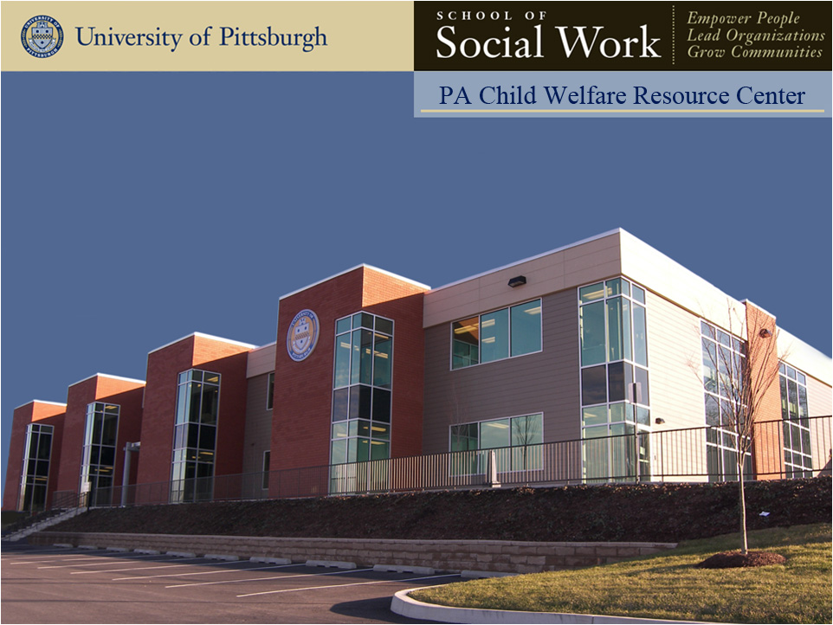
108: Multi-Generational Differences in the Workplace
108: Multi-Generational Differences in the Workplace

Slide 2
Learning Objectives
Participants will:
Identify the values, cultural influences and career expectations that influence the work styles of each of the four generations
Recognize the myth from reality related to the values and ethics each generation brings to the work environment
Outline a plan designed to create and support productive multi-generational teams in their agency
Notes:
Review slide

Slide 3
Agenda
Section I: Welcome and Introductions
Section II: Facts, Figures, and Data
Section IV: How Generational Differences Relate to Everyday Issues
Section V: Conclusion
Notes:
Review Slide

Slide 4
What’s in it for children and family?
What is one way learning about multigenerational differences in the workplace can support children and families?

Slide 5
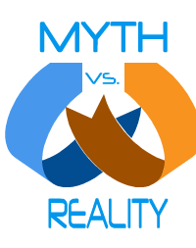
Myth vs. Reality
Notes:
Small group discussion – myths and realities
Large group processing and discussion
Add actual barriers and strengths

Slide 6
Generational Breakdown
Baby Boomers – Born between 1946 and 1963
Generation X – Born between 1963 and 1981
Generation Y – (Millennials, Echo Boomers, Nexters, Nesters) – born between 1981 and 1996
Generation Z - (Centennials, iGeneration, Digital Natives, Zoomers) - born between 1996 and 2012
Notes:
Potential for 4 generations to be working together for the first time in history.
US Census Bureau reports that 23% of Americans age 65-74 are still in the workforce.
Baby Boomers (age 62-44)
Gen X (age 43-28)
Gen Y (age 27- 9)
Gen Z (age)
This may create a generation gap of more than 40 years between the oldest and youngest worker in your workplace. We can no longer apply a “one size fits all” mentality to leadership of a multi-generational workforce.
Discussion - like any other – is not designed or intended to “pigeon hole” someone. Rather to improve awareness and opportunity for successful team dynamics…… Want to be careful not to feed into the “myths” focus on the realities…..

Slide 7
Baby Boomers
Born between 1946 and 1964
Approximately 80 million of the nation’s employees
Respond to symbols of recognition – titles, money, special perks, status symbols or peer recognition
Optimistic and idealistic
Competitive (because of their large numbers, had to be)
The Diversity Manager’s toolkit
Notes:
Review Slide

Slide 8
Generation X
Born between 1965 and 1980
Approximately 46 million of the nation’s employees
Typically, little trust in the system
Freedom seen as ultimate corporate reward
Want to enhance their skills
Portable benefits – 401Ks – that can be taken anywhere
Skeptical
The Diversity Manager’s toolkit
Notes:
Review slide

Slide 9
Generation Y (Millennials, Echo Boomers, Nexters, Nesters)
Born between 1981 and 1995
Perceived as wanting to make a difference and know their work has value
Question authority for the right reasons
Characteristics include sociability, civic duty, morality
The Diversity Manager’s toolkit
Notes:
Review Slide

Slide 10
Generation Z (Centennials, iGeneration, Digital Natives)
Born between 1996-2012
Perceived as wanting to make a difference and know their work has value
Question authority for the right reasons
Characteristics include sociability, civic duty, morality
The Diversity Manager’s toolkit

Slide 11
Statistics
According to catalyst.org, in 2016, Millennials became the largest generation in the US workforce.
According to Gallup poll, Gen Z and millennials combined represent 46% of the full-time US workforce.

Slide 12
Historical Influences
 | Baby Boomers | Generation X | Millennials (Generation Y | Centennials (Generation Z, iGeneration or Digital Natives)
Timeline | 1946-1964 | 1965-1980 | 1981-1995 | 1996-2012
Historical Events | Civil Rights Movement Sexual Revolution/ Rock and Roll Cold War Space Travel Assassinations | Watergate Women’s Liberation Energy Crisis Space Shuttle Challenger Explodes Desert Storm | Oklahoma City Bombing Columbine School Shootings Technology Child Focused World Clinton/ Lewinsky 9/11 | Obama Election Wars in Afghanistan and Iraq
Notes:
Everyone is a product of many influences – develop our personal “frame of reference”
Here are some Historical Influences each of our generations experienced……
Review slide

Slide 13
Core Values
 | Baby Boomers | Gen Xers | Millennials | Centennials
Outlook | Optimism, Involvement | Skepticism, Informality, Fun | Realism, Confidence, Social, Extreme Fun | Volunteering, Community, non-profits, sharing experiences, actions over words
Family | Disintegrating | Latch-Key Kids | Merged families | Most ethnically diverse generation
Education | A birthright | A way to get there | An incredible expense | Most trained and well-educated generation in history
Notes:
What we value also influences our behavior and actions….
Look at some key areas and how each generation might “respond”, or view the area….
Review slide

Slide 14
Core Values
 | Baby Boomers | Gen Xers | Millennials | Centennials
Communication | Touch-tone phones, Call me anytime | Cell phones, if it is about work, only call me at work | Internet, E-mail, Picture phones, I-pods | Constant access to technology – send texts, tweets, and instant messages Use abbreviations, informal language and colloquialism
Money | Buy now, pay later | Cautious, Conservative, Save | Earn to spend | Value financial security above all
Work Ethic | Workaholic, Live to work, Long hours to establish self-worth, Identity and fulfillment | Work smarter not longer, Work to live, Want structure and direction, Skeptical | Hard workers, but like to have fun, Multi-tasking, Entrepreneurial, Tolerant | Self-sufficient Interest not solely in going to work to work, but also to learn Value an inclusive workplace Want to participate in decision making and have their ideas valued

Slide 15
Core Values
 | Baby Boomers | Gen Xers | Millennials | Centennials
Work/ Life Balance | Were hesitant of taking too much time off from work for fear of losing their place on the corporate team. As a result, there is an imbalance between work and family. | Have a clearer balance between work and family, Do not worry about losing their place in the corporate team if they take time off | Not only balance work and life, but balance work, life and community involvement and self-development. Flex time, job sharing, and sabbaticals will be requested more by this generation. | Focus on flexibility and a culture of “unplugging” with high respect for personal time
Source: Megan Martin's "Generational Differences in the Workplace"

Slide 16
Core Values
 | Baby Boomers | Gen Xers | Millennials | Centennials
Career Development | Focus on developing their careers through opportunities within one organization or at least one industry, Moved up based on seniority not always based on skill or expertise | Pro-active approach to career development, through more degrees and experiences both within the organization and without. This is often seen as dis-loyal to the company, but Gen X-ers see it as being loyal to themselves | More experience entering work force, Want more experience and opportunities, If they don’t get it at work, they will seek it elsewhere | Role hoppers No interest in titles Interest in learning different tasks or taking projects outside of their designated role Entrepreneurial

Slide 17
Core Values
 | Baby Boomers | Gen Xers | Millennials | Centennials
Job Expectations | Need clear and concise job expectations. Like to achieve work through teams | Need reason for task, May question, Need to be engaged or may seek engagement in another position | Don’t want boring jobs; they want to make a difference. Because of being a product of the “drop down and click menu,” they may need to be given a list of options. | Embrace diversity and inclusion Focus on generate a positive impact in the world
Training and Development | Training is a contribution to the organization’s goals, but is also a path to promotion and compensation | Enhances versatility in marketplace and investment in future. Not necessarily loyal to the company that trained them | Willing and eager to take risks, Don’t mind making mistakes – consider this a learning opportunity | Robust training and leadership programs, with a real and tangible focus on diversity Do not go to work just to work, but also to learn

Slide 18
Core Values
 | Baby Boomers | Gen Xers | Millennials | Centennials
Rewards and Compensation | Take pride in a lot of work being achieved; like to be recognized for those achievements. | Fair compensation, Earn extra for doing extra, Value time off, Seek an enjoyable atmosphere | Seek opportunities to take on and be a part of projects. They need to have fun, and have a sense of control over their environment | Flexibility Need independence Health Insurance is a must-have
Providing Feedback | Official feedback once a year. Job coaching began with the Baby Boomers. | Self-sufficient, so give them structure, Coach but implement hands-off supervision | Teamwork, Like feedback and will ask for it often | Need feedback regularly

Slide 19
Core Values
 | Baby Boomers | Gen Xers | Millennials | Centennials
Retirement | If I retire, who am I? I haven’t saved any money, so I need to work, at least part-time. I’ve been downsized so I need to work, at least part-time. | I may retire early; I’ve saved my money. I may want different experiences and may change careers. I may want to take a sabbatical to develop myself | Jury is still out, but will probably be similar to the Gen Xers | 1 in 5 members of this generation expect to retire around 50
Adapted from Martin, M. (2005). Generational Differences in the Workplace

Slide 20
Tips for Working Across Generational Divides
Important to understand the other person’s point of view – relationships, relationships, relationships
Don’t assume traditional behaviors – break down of the charts
Keep an open mind
WANT to learn new things and look at things differently

Slide 21
Tips for Working Across Generational Divides
Listen
Earn respect and be respectful
Spend time with co-workers – one-on-one
Communicate
Be an employee who doesn’t have to be “managed”

Slide 22
Small Group Activity Breakout Rooms
Consider a current or pending organizational issue that may be impacted by generational issues and identify the following:
What are the strengths and weaknesses of individuals involved?
What other things need to be considered beyond the generational differences?
What system/structures/processes impact this issue?
What are some quick wins that we can identify to try to rectify this issue?
What are the roles and responsibilities of those that are involved?
Complete an action plan to figure out who will do what by when.

